Slide 1
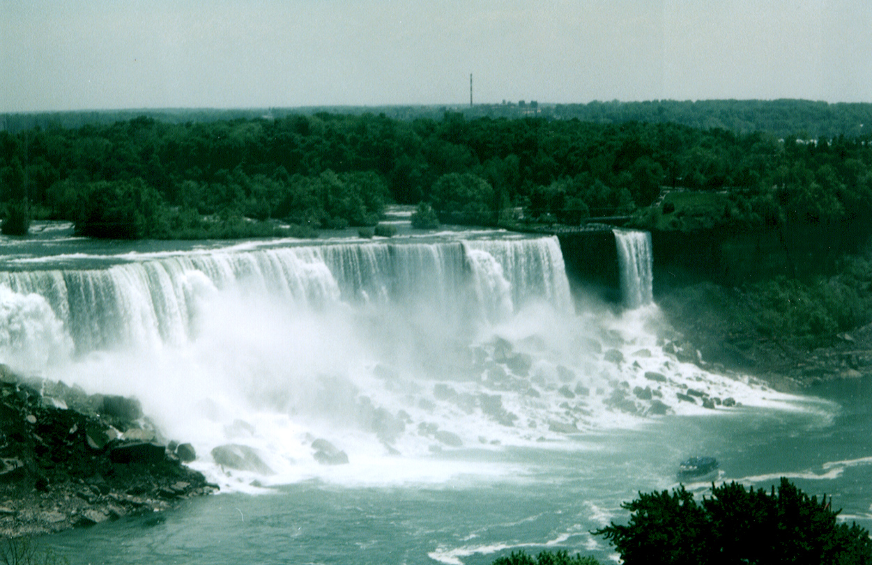
HOMEOSTATIC CONTROL OF FLUID LEVELS

Slide 2
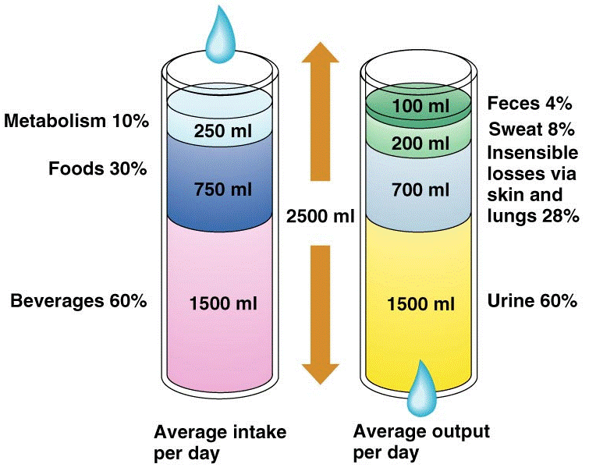
FLUID INPUT MUST = FLUID OUTPUT

Slide 3
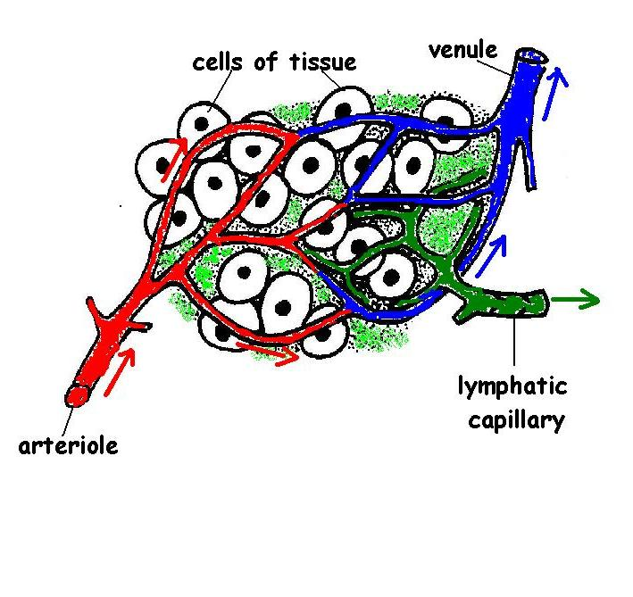
BALANCE BETWEEN INTRACELLULAR & EXTRACELLULAR FLUID
Any osmotic difference between the intracellular & extracellular environment is quickly restored by osmosis through the plasma membrane of the cell.

Slide 4
FLUID COMPARTMENTS
TYPE OF FLUID | EXAMPLES OF THE FLUID TYPE
INTRACELLULAR FLUID | Fluid inside the cell- CYTOSOL (Makes up 67% of the total body fluid)
EXTRACELLULAR FLUID | Fluid outside cells (33% of the total body fluid). PLASMA FLUID (the fluid within the blood) makes up 25% of the extracellular fluid. INTERCELLULAR/ INTERSTITIAL (the fluid found between cells) makes up 75% of the extracellular fluid. Examples of intercellular fluid include; lymph, cerebrospinal fluid, filtrate, synovial fluid and any other fluid not in a cell.

Slide 5
EXCRETION
Is the removal of metabolic wastes
EXCRETORY ORGAN | METABOLIC WASTE EXCRETED
LUNGS | CARBON DIOXIDE, WATER VAPOUR
SKIN | UREA, SALTS, LACTIC ACID
ALIMENTARY CANAL | BILE PIGMENTS FROM HAEMOGLOBIN
KIDNEYS | UREA, WATER, SALTS

Slide 6
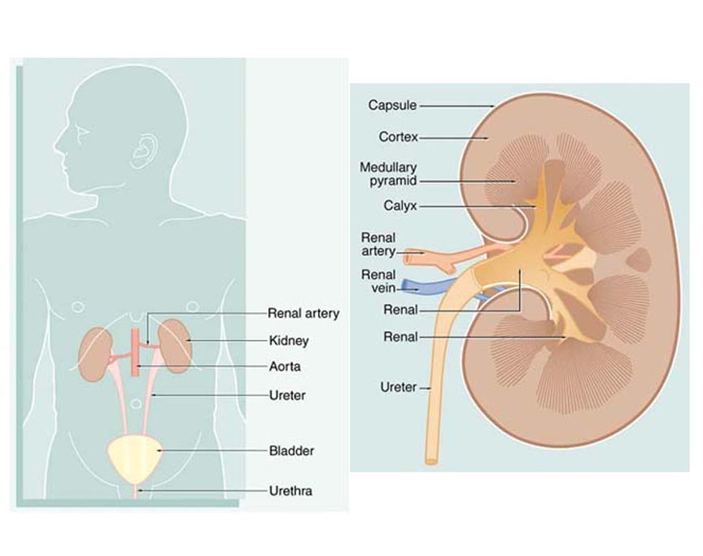
MACROSCOPIC STRUCTURE OF THE KIDNEY

Slide 7
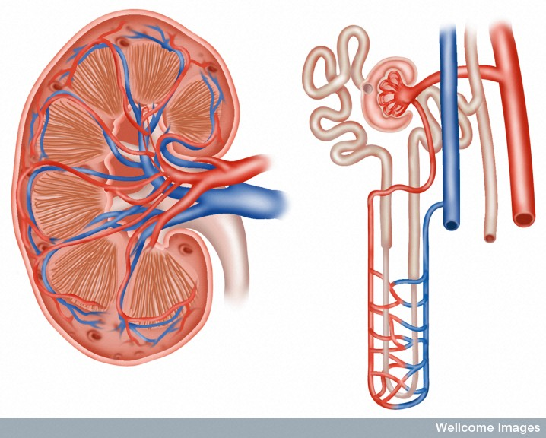
REVISION
Filtration of small molecules from the glomerulus into the renal capsule.
Reabsorption of glucose, water, amino acids from filtrate back into peritubular capillaries.
Secretion of substances from peritubular capillaries into the filtrate.

Slide 8
CONTROL OF WATER LOSS BY KIDNEYS
Occurs under the influence of ADH from the posterior pituitary gland.
High blood levels of ADH cause the distal convoluted tubule & collecting tubule to be more permeable to water.
ADH stimulates facultative reabsorption which is the active reabsorption of water.
The greater the reabsorption of water, the more concentrated the urine will be and vice versa.

Slide 9
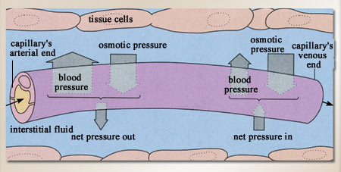
STIMULUS- RESPONSE FOR LOW BLOOD FLUID LEVELS
STIMULUS
Osmotic pressure increases due to low blood plasma levels.
RECEPTOR
Osmoreceptors in the hypothalamus detect the high osmotic pressure

Slide 10
MODULATOR
Hypothalamus stimulates the posterior lobe of the pituitary gland to release ADH.
EFFECTOR
Distal convoluted tubule & collecting tubules of the kidney become more permeable to water.
RESPONSE
Water is reabsorbed from the filtrate. Urine volume is decreased and becomes more concentrated.
FEEDBACK
Blood plasma levels increase, osmotic pressure decreases.

Slide 11
REGULATING WATER INTAKE- THE THIRST REFLEX
STIMULUS
Osmotic pressure increases due to low blood plasma levels, mouth feels dry.
RECEPTOR
Osmoreceptors in the hypothalamus detect low blood plasma levels and gives the person a conscious recognition that they feel thirsty.
MODULATOR
Hypothalamus/ cerebrum

Slide 12
THIRST REFLEX Cont...
EFFECTOR
Dry throat
RESPONSE
Individual drinks fluid and water is absorbed into the blood through the alimentary canal
FEEDBACK
Extracellular & intracellular fluid levels return to normal. Osmotic pressure decreases. Mouth feels wet.

Slide 13
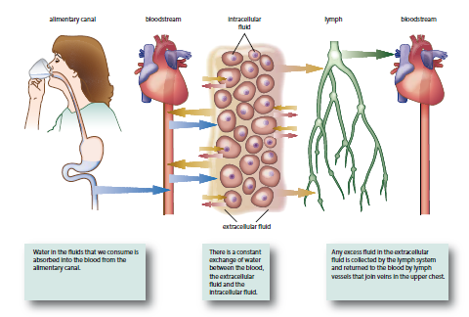

Slide 14
Reabsorption of salt under the influence of aldosterone
Stimulus
Decreased blood volume → reduced blood pressure
Receptor
Baroreceptors in Renal artery sensitive to blood pressure

Slide 15
Transmission
Several chemical messengers ending with release of aldosterone from the adrenal cortex
Effector
Sodium pumps in renal distal convoluted tubule and collecting duct pumps sodium out of filtrate and potassium into filtrate and excreted into urine.
Response
Sodium reabsorbed into interstitial fluid and bloodstream increase ion concentration in interstitial fluid and in blood stream (creates osmotic gradient)
Water is reabsorbed along with the Na ions and therefore aldosterone also plays a roll in incr water absorption and therefore incr in blood volume and therefore blood pressure

Slide 16
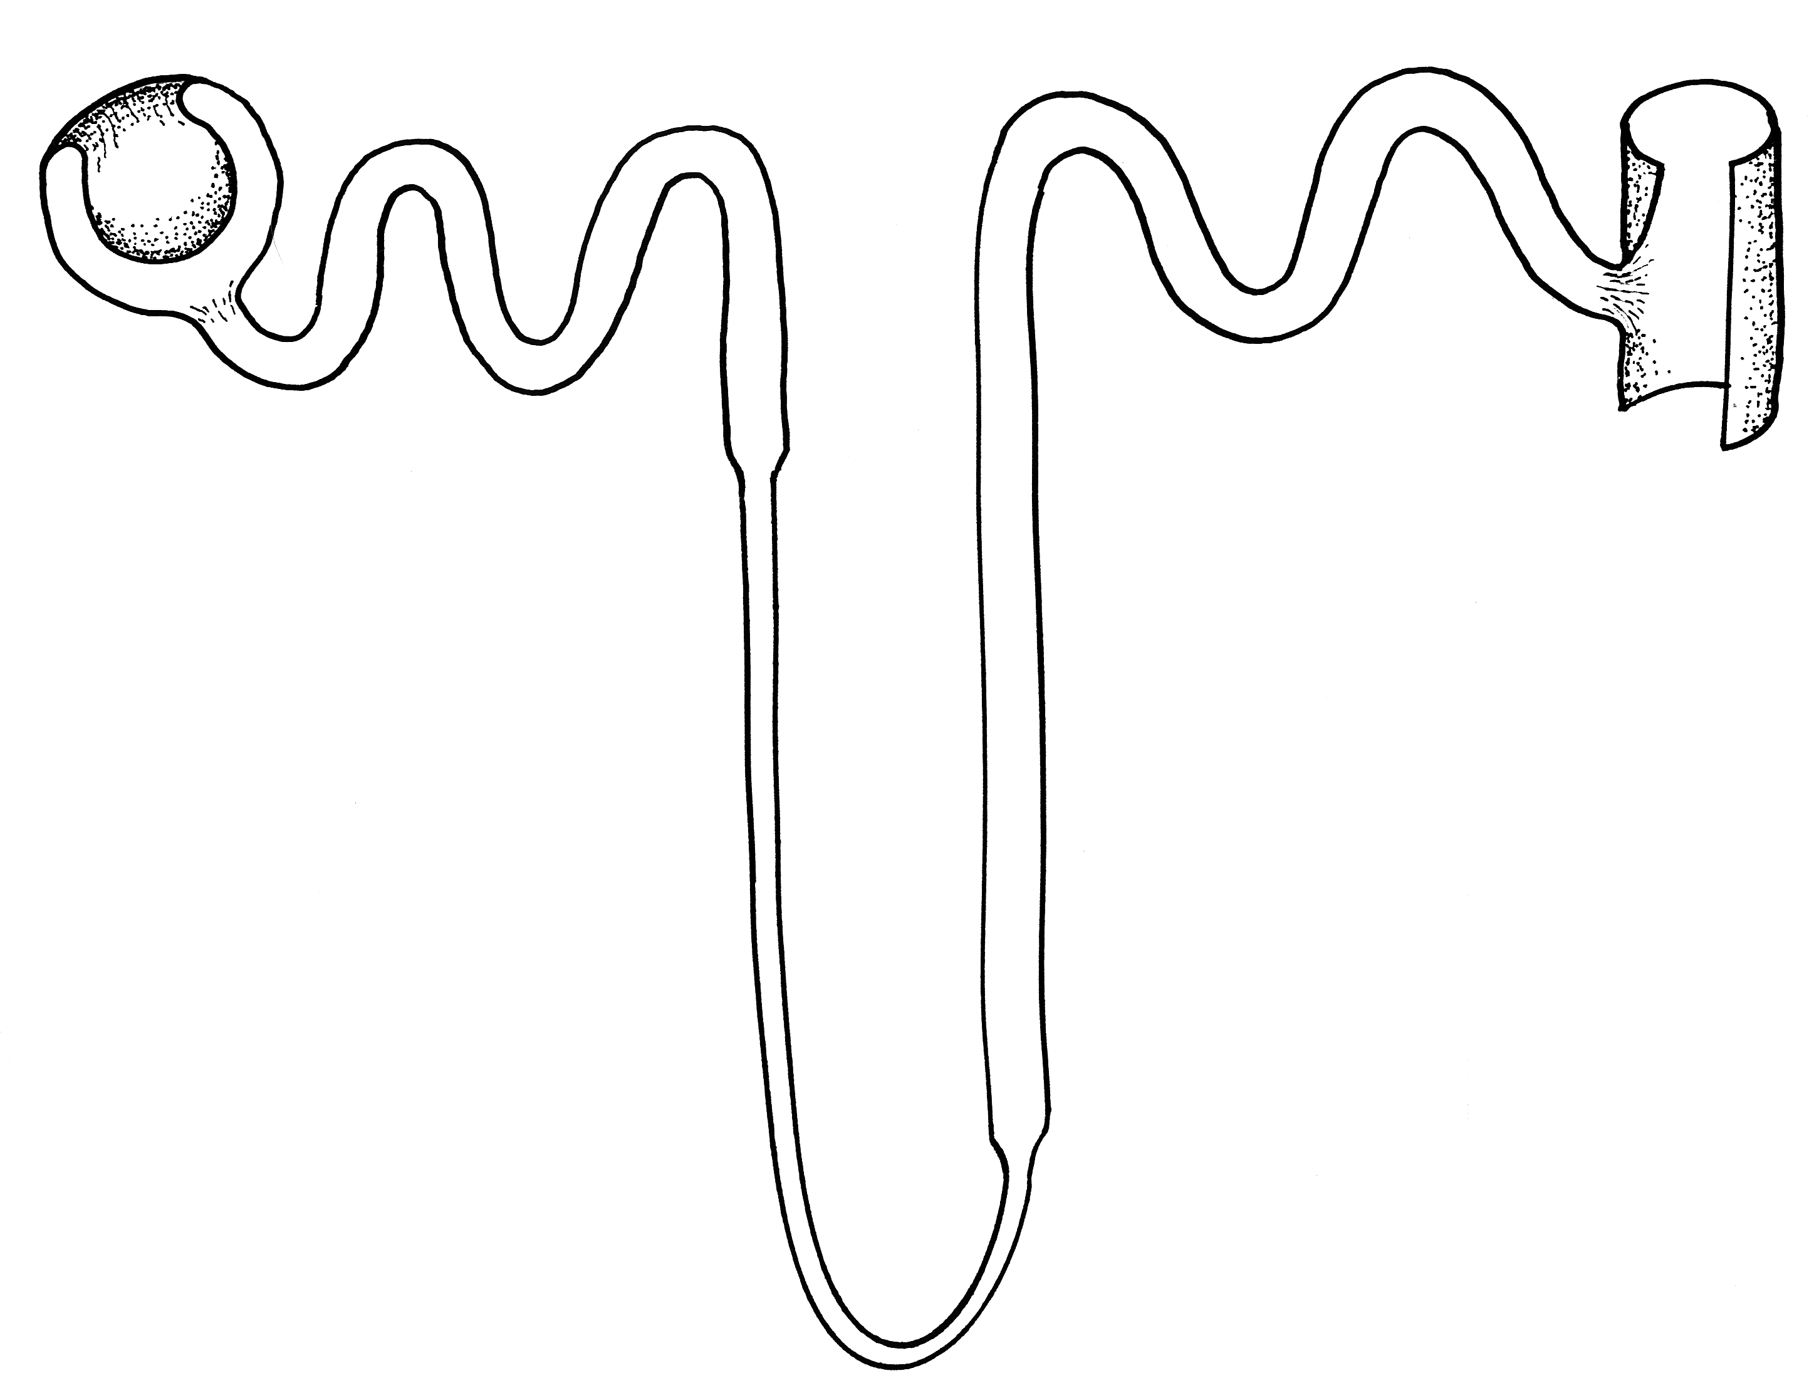
Low
Na+
concentration
In filtrate and high pos K ions
filtrate
Aldosterone
stimulates sodium pumps
High
Na+
concentration
In
tissue
Fluid and bloodstream.
K pos ions are secreted into filtrate
Na+
Na+
Na+
Na+

Slide 17
Negative feedback loop
Decreased blood volume → reduced blood pressure
Baroreceptors in Renal artery
Stimulus
Receptor
End-product is aldosterone from adrenal cortex
Creates osmotic gradient and water follows which will incr blood volume and consequently blood pressure
Control
centre
Feedback
Response
Effector
Sodium reabsorbed into bloodstream and K pos ions secreted into filtrate
Sodium pumps in renal tubule

Slide 18
TERMINOLOGY
Dehydration- when water loss exceeds water intake.
Water intoxication- when there is too much water in the body.
Usually occurs when the individual replaces the loss of fluids with plain water and doesn’t replace the salts lost. The body fluids become too diluted and cells take in too much water via osmosis.

